Slide 1
Junior Radiology 2011

Slide 2
Goals & Objectives
Short Course
Overview of radiology and its subspecialties
Lots of information
  Overwhelming
  Advanced
Lsuhsc.edu Schools Dept of Radiology Education

Slide 3
Goals & Objectives
Attend lectures & Listen
Attempt to learn at least one new principle
Do not worry about the final exam
    Written
    Practical
Pay attention & you will pass with 100%

Slide 4
Learning Radiology textbook
http://www.learningradiology.com/

Slide 5
Goals & Objectives
  Course Evaluation:
    Important
    We listen to what you want
    Please take your time to complete

Slide 6
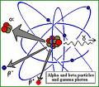
Radiology
Diagnostic
Therapeutic

Slide 7
Diagnostic Radiology
Subspecialties
Emergency
Radiology
Chest/Pulmonary
Nuclear Medicine
Ultrasound
Musculoskeletal
Cardiac
Pediatric
Mammography
Abdominal Imaging
Gastroenterology
Genitourinary
Neuroradiology
Vascular & Interventional

Slide 8
“Must See” diagnoses
for medical students
Pneumoperitoneum: perf. viscus
Pyelonephritis “striate”/abscess
Cholelithiasis vs. Cholecystitis
Appendicitis (CT preferred)
Diverticulitis (LLQ pain)
Ischemic Colitis can get pneumotosis coli/ PV intrahep air
Hemorrhage= Leaking aneurysm

Slide 9
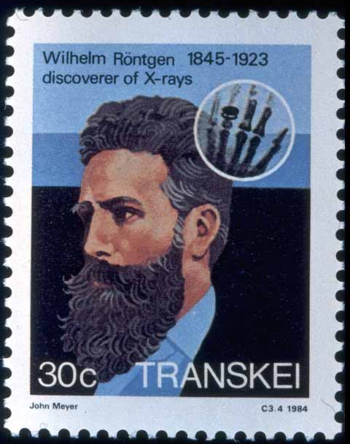
1895: Roentgen discovers X-rays
(by accident) www.xray.hmc.psu.edu/rci/centennial.html

Slide 10
What is an X-ray?
X-rays are very short wavelength electromagnetic radiation. Shorter wavelength, greater energy/greater the ability to penetrate matter
X-rays are described as packets of energy called Quanta or Photons
Photons travel at the speed of light
Photon energy measured in Electron Volts

Slide 11
X-ray beam absorption and attenuation
X-Rays passing through matter become ATTENUATED via absorption and scatter.
For a given thickness, the greater the physical density (gm/cc) of a material, the greater its ability to absorb or scatter X-Rays.
  Lead >Aluminum

Slide 12
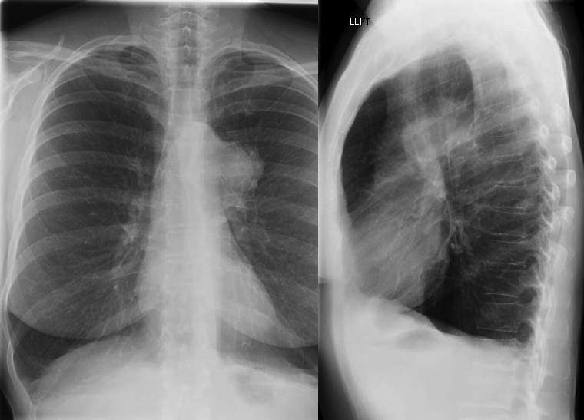
More photons
strike the film
film appears
BLACKER
Fewer photons
strike the film
=> film appears whiter
www.med.harvard.edu/JPNM/TF03_04/Sept2/CXR.jpg

Slide 13
X-ray beam absorption and attenuation
X-Rays passing through matter become ATTENUATED via absorption and scatter
With increasing atomic number comes
increasing attenuation by the material

Slide 14
Radiographic Densities
Metal Very White
Bone White
Water Gray
Fat Gray-Black
Air Black
Metal is most Radiodense or Radiopaque
Air is most Radiolucent

Slide 15
Hounsfield Unit Scale
(CT Attenuation)
Gas (Air) -1,000 HU
Fat -100 HU
Water 0 HU
Soft tissue +20 to +100 HU
Bone +1,000 HU

Slide 16
Ionization
An atom which loses an electron is ionized
Photons having ≥ 15 electron volts can produce ionization in atoms and molecules
X-Rays, Gamma Rays, and certain types of UV Radiation are Ionizing Radiation

Slide 17
LIMITING YOUR EXPOSURE:
You do the math!
Doubling your distance from the X-ray tube reduces your exposure by a factor of four
Tripling your distance from the X-ray tube reduces your exposure by a factor of nine!

Slide 18
RadTech uses collimation and lead apron to reduce exposure

Slide 19
Ionizing Radiation in Radiology
Patients undergoing these types of studies are exposed to Ionizing Radiation:
  Radiographs
  Fluoroscopy/Conventional Angiography
  CT
  Nuclear Medicine

Slide 20
Multi-Detector (Helical) CT multiple planes of detectors in the gantry
Technical innovation allows
  even faster scanning
  over a much longer range
  with even better image quality
Radiation exposure greater than single-detector CT
“Total body” CT in trauma pts

Slide 21
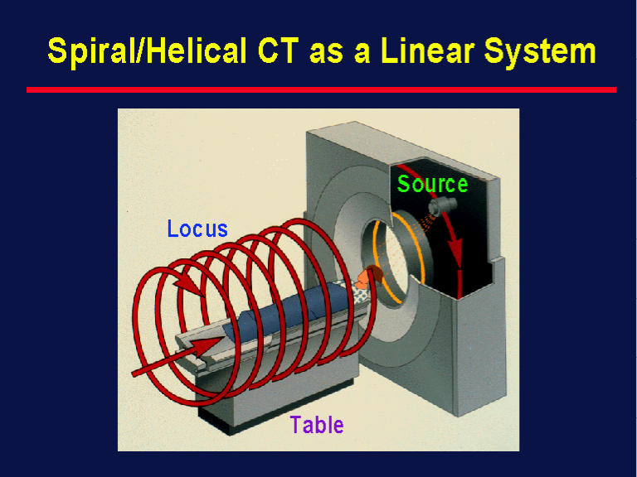
Helical CT: A volumetric examination
synonym: Spiral CT
Tube and table move:
Tube: circular path
Table: translocation
CT computer creates
discrete images
from this
volume of data

Slide 22
MAIN ADVANTAGES
OF
CT OVER MRI
Rapid scan acquisition
Visualization of cortical bone and soft tissue calcifications

Slide 23
Exposure to Ionizing Radiation causes two types of effects
Deterministic Effects: A minimum threshold dose must be attained for the effect to occur. Examples include cataract formation, skin reddening (erythema), and sterility. Also referred to as “non-stochastic” effects
Stochastic Effects: The effect may (potentially) occur following any amount of exposure – there is no threshold. Examples include cancer and genetic defects.

Slide 24
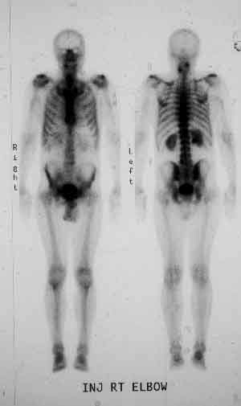
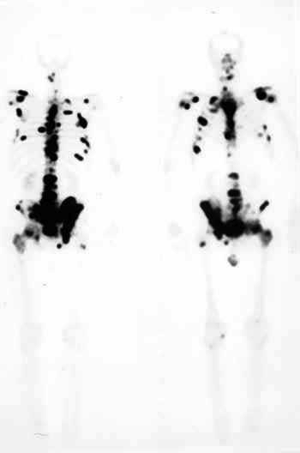
Normal bone scan mets
Posterior Anterior
Anterior Posterior
Diethelm MD Lisa

Slide 25
Nuclear Medicine
Photons emitted by radioisotopes are detected by Sodium Iodide crystals. Brightness of light emitted depends on the energy of the photon
Photodetectors convert the light into an electronic signal, which a computer converts to diagnostic images………

Slide 26
Nuclear Medicine
Most imaging modalities detect changes in gross anatomy
However, most NM exams rely on changes in physiology to detect disease.
Radionuclides
  Produce ionizing radiation
  Administered I.V., orally, SubQ

Slide 27
PACS Training
Picture Archiving and Communication System
Digital system for storage, retrieval, and display of imaging studies
ILH is completely filmless =PACS is your only access to your patients’ images
Therefore, you are encouraged to learn to use PACS

Slide 28
Contrast Media
Most viscera are of water-density or close to it
Contrast media are materials we introduce to better define anatomy and pathologic changes

Slide 29
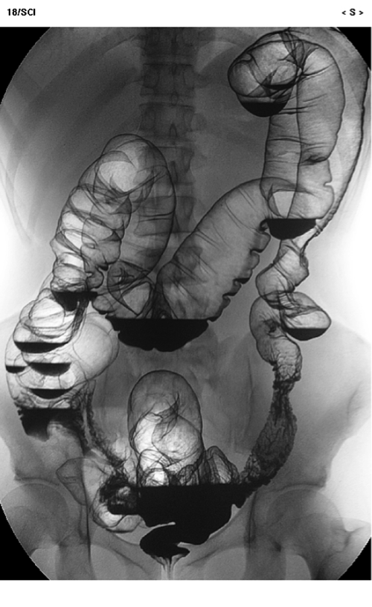
Barium enema
www.philips.com/
Main/products/xray/
Assets/images/dose
Wise/urf2_large.jpg

Slide 30
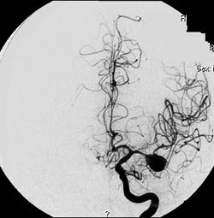
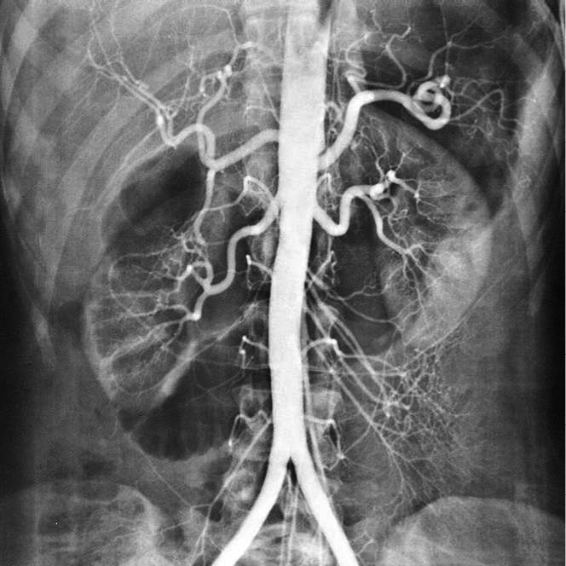
Angiography uses intravenous contrast medium
depts.washington.edu/.../brain_aneurysm.html

Slide 31
Iodinated Contrast Reactions
Mild Warmth, metallic taste, N/V, HA, Dizziness, Tachycardia, sneezing, coughing, erythema,
Moderate Agitation, bradycardia, hypotension, wheezing, urticaria (“hives”), itching
Severe Pulm edema, shock, CHF, cardiac arrest, laryngospasm, laryngeal edema, apnea, seizure, coma

Slide 32
Common Indications for
IV Contrast in CT
To visualize blood vessels
(Aortic injury, Abdominal Aortic Aneurysm, Pulmonary Embolus)
To evaluate for primary or metastatic tumor
To evaluate for infection or inflammatory processes
To evaluate for traumatic injury

Slide 33
CT
Contrast resolution far superior to plain radiographs, but spatial resolution inferior to XR
Thinly collimated x-ray beam passes through a “slice” of the patient’s body while the x-ray tube moves in an arc around the patient
Electronic detectors, placed opposite the x-ray tube, convert the attenuated x-ray beam into electrical pulses.Computers convert this data to a gray-scale image

Slide 34
MRI Contrast Media
Gadolinium
  Paramagnetic (radiopaque)
  IV
  NSF/ check GFR=renal function

